Slide 1
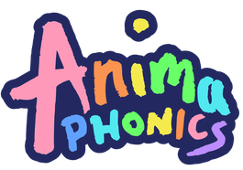
Welcome to Anima Phonics! This presentation will explain how children are taught to read and write in school

Slide 2
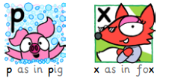
What is phonics?
There are 26 letters in the alphabet and each letter has its own ‘sound’. For example
p as in pig
a as in apple
t as in tiger

Slide 3
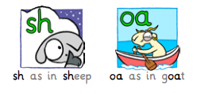
However, there are more than 26 ‘sounds’ in English - there are 44 in fact! - and we use combinations of letters to make these sounds.
A digraph uses two letters to make one sound.
In Anima Phonics, digraphs are coloured green to make them easier to identify.

Slide 4
Why learn phonics?
Children need a clear and consistent method to use when reading and writing.
Learning to read with phonics is much easier and simpler than trying to memorise thousands of words!
Decades of research tells us that teaching children the phonics ‘code’ is the quickest way to unlocking the English language.

Slide 5
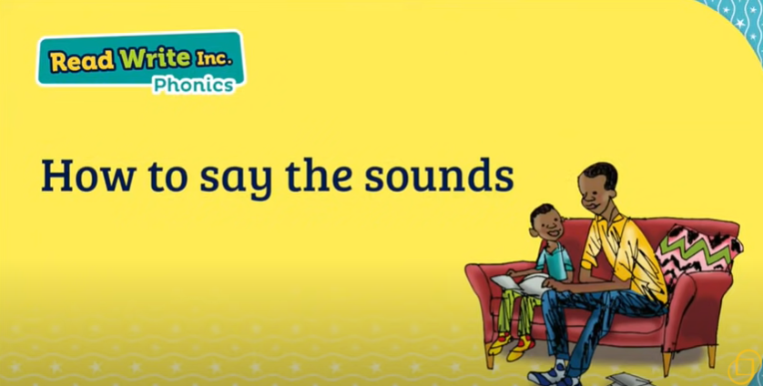
We teach phonics using pure sounds

Slide 6
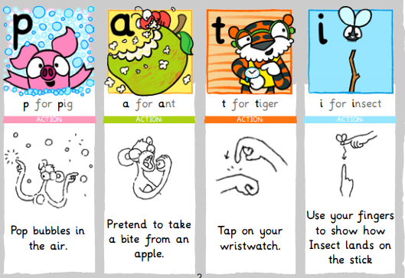
How is Phonics taught in school ?
Each ‘sound’ is introduced with a poem and action to aid speedy recall.
The 44 sounds are gradually introduced in a systematic order.

Slide 7
Phonics glossary
Phoneme - A sound as it is said aloud.
Grapheme - A sound as it is written.
Digraph - A combination of two letters representing one sound, as in ay and ee
Naughty Digraph – Alternative spellings ok known digraphs, e.g. ay
Trigraph - A combination of three letters representing one sound, as in igh and ear
Blending - This involves looking at a written word and merging the phonemes together to make the word. This is the basis of reading.
Segmenting - This involves splitting a word up into phonemes and writing the matching graphemes on the page. This is the basis of spelling.

Slide 8
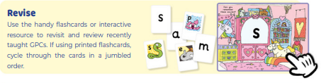
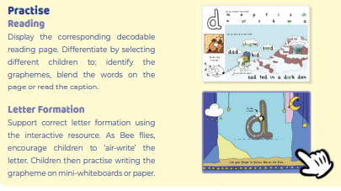
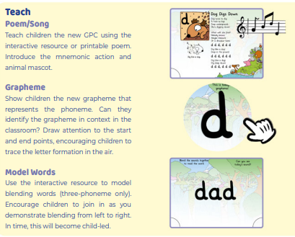
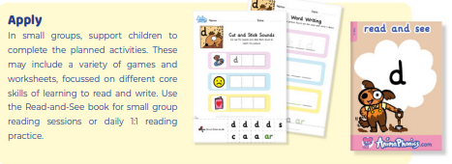
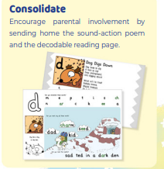
How is a typical lesson sequenced?

Slide 9
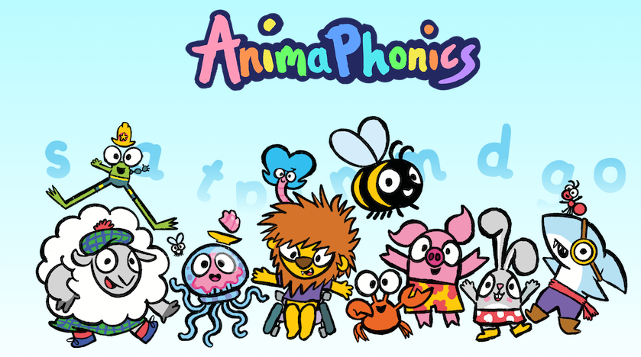
Let’s take a look at a typical lesson . . .

Slide 10
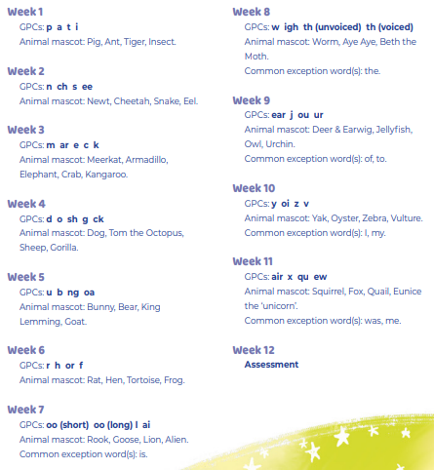
Order of Progression: Term 1

Slide 11
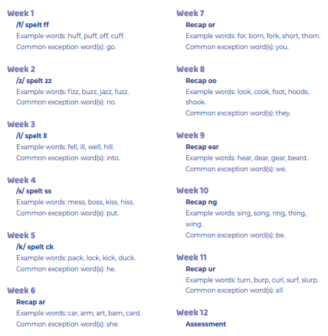
Order of Progression: Term 2

Slide 12
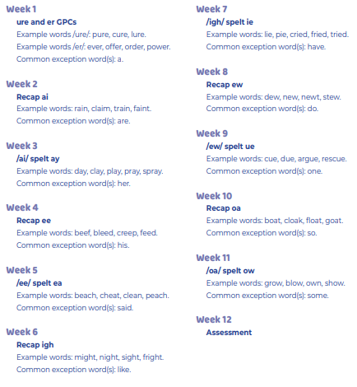
Order of Progression: Term 3

Slide 13
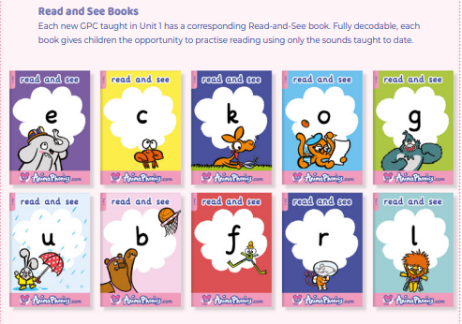
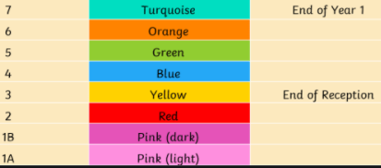
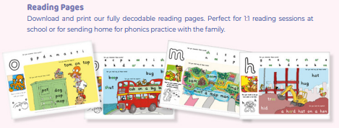

Fully Decodable Texts - Books for Learning
Reading at Home and School
Colour Bands – Books for Sharing
Books for Bedtime

Slide 14
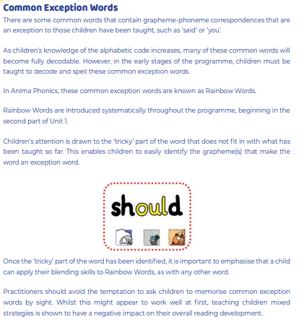
Rainbow Words

Slide 15
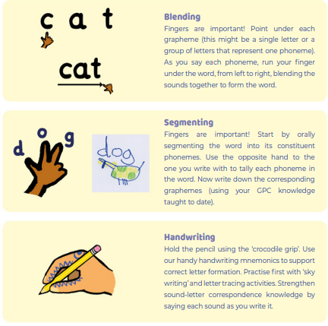
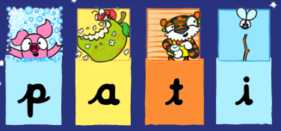
Top Tips!
We use pre-cursive handwriting

Slide 16
How can parents support at home?
Make reading part of your daily routine - children who read at home, even just for a few minutes each day, make really noticeable progress compared to those who do not. ( please remember to write in home reading record)
No distractions - find a quiet space to read aloud together, asking your child to help out if they know any of the sounds.
Practising sounds and actions - following how they are taught in school is one of the best ways to support children in reading.

Slide 17
Talk about what they are reading - talk before, during and after reading a book. Talk, talk, talk! Forget the alphabet (for now) - whilst it’s tempting to use the names of the letters, this doesn’t help a child when trying to read a word. Only refer to the sounds the letters make.
Identify tricky words - Before reading with your child, identify any words that might be difficult, so that they have confidence when they see the word in the book.
Be patient - give children time to decipher words. Encourage your child to point a finger at each sound and then slide their finger along the word to blend the sounds together.

Slide 18
Other Ways to Support your child’s Reading
Sing an alphabet song together
Play ‘I spy’
Continue to play with magnetic letters, using some two-grapheme (letter) combinations, eg: r-ai-n = rain blending for reading
rain = r-ai-n segmenting for spelling
Praise your child for trying out words
Look at tricky words
Look for phonic games – phonicsplay.co.uk
Play pairs with words and pictures

